Slide 1
Painless Functional Specifications – Why Bother?
Michael Tsai
2012/10/25

Slide 2
Reference
http://www.joelonsoftware.com/articles/fog0000000036.html

Slide 3
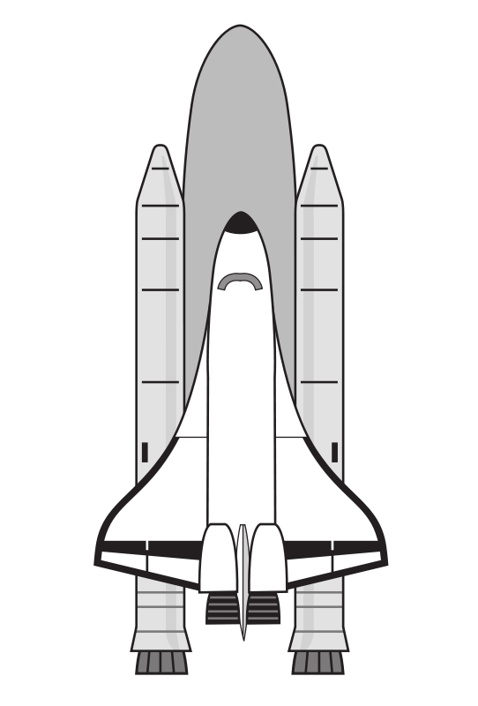
為什麼要寫spec.?
Spec. (Specification)不是只給
NASA的太空梭工程師
替巨人工作的人.
“Failing to write a spec is the single biggest unnecessary risk you take in a software project.”
Guideline:
超過一個星期, 或者超過一個人的software project都需要寫spec.

Slide 4
Specification是做什麼的?
The most important function of a spec:
當詳細的描述程式怎麼運作的時候, 強迫你怎麼實際去設計程式.
Design the program

Slide 5
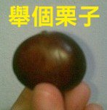
超速小姐, 匆忙香蕉軟體公司
從來不寫spec
羅傑先生, 好脾氣軟體公司
完全寫完spec以後才開始真的寫code
兩個工程師都負責他們公司產品v2.0的backward compatibility

Slide 6
超速小姐
寫什麼spec. 我決定提供backward compatibility的最好方法是寫一個把版本1.0的檔案轉成版本2.0檔案的轉換器
兩周後…他完成了.
客戶不開心☹ 因為使用的公司必須全部使用者都立刻升級到2.0
大客戶: 我想要知道2.0軟體是否可以使用1.0版本的檔案而不將它們轉換到2.0版本的檔案
超速小姐花了另外兩周寫了一個把2.0版本檔案轉回1.0版本檔案的轉換器, 並且連結到”儲存”的功能下.
結局: 花了四週時間. 但是功能性不太好: 因為如果你使用了很多2.0版本的功能, 但需要儲存成1.0版本的檔案, 儲存的時候你會被迫要放棄剛剛用的很多東西 →抓狂.

Slide 7
羅傑先生
Spec 0.1: (花了20分鐘)
When opening a file created with an older version of the product, the file is converted to the new format.
顧客: 我們不要全部一次都upgrade!
Spec 0.2: (花了20分鐘)
When opening a file created with an older version of the product, the file is converted to the new format in memory. When saving this file, the user is given the option to convert it back.
老闆(OOP人)不喜歡…..做了一些更動:

Slide 8
羅傑先生
Spec 0.3: (花了20分鐘)
The code will be factored to use two interfaces: V1 and V2.
V1 contains all the version one features, and V2, which inherits from V1, adds all the new features.
Now V1::Save can handle the backward compatibility while V2::Save can be used to save all the new stuff.
If you’ve opened a V1 file and try to use V2 functionality, the program can warn you right away, and you will have to either convert the file or give up the new functionality.

Slide 9
羅傑先生
羅傑先生不開心….因為用spec 0.3很複雜, 要花3星期才能寫好. 然而所有客戶的問題似乎都可以解決, 因此他花了3星期來把這部分寫好.
結局: 花了3星期+1小時. 但是所有的問題都解決了.

Slide 10
The moral of the story
When you design the product in human language:
it takes only a few minutes, and
nobody feels bad to modify it.
When you design your product in a programming language:
it takes weeks to do iterative designs.
And the programmer will defend the code he/she wrote, no matter how wrong it is.

Slide 11
The moral of the story
“the best design we could get, given that we’d already written all this code and we just didn’t want to throw it away”
versus
“the best design we could get, period.”

Slide 12
Save time communicating
Customer
Developer
Business development people
Spec
Manager
QA people
Marketing people
Technical Writer

Slide 13
When there’s no spec…
QA people asks the programmers about the product...
Interrupt the programmer.
Ruin their productivity.
The programmers give the answer corresponding to what they wrote, not “the right answer”
QA people is testing the program against the program, not the program against the design!

Slide 14
When there’s no spec…
Technical writers are the poorest people.
“Would you like to enable LRF-1914 support?”
“Allows you to choose between LRF-1914 support (default) or no LRF-1914 support. If you want LRF-1914 support, choose “Yes” or press “Y.” If you don’t want LRF-1914 support, choose “No” or press “N.”

Slide 15
Make it possible to make a schedule
No schedule is okay?
“We’ll ship when we’re good and ready”
Time → cost

Slide 16
Spec的好處們
Come up with the best design, no compromises
Save time communicating
Without a spec, it is impossible to make a schedule.
Make (all important) decisions early.

Slide 17
Reading Assignment: 續集們
http://www.joelonsoftware.com/articles/fog0000000035.html
http://www.joelonsoftware.com/articles/fog0000000034.html
http://www.joelonsoftware.com/articles/fog0000000033.html

